Slide 1

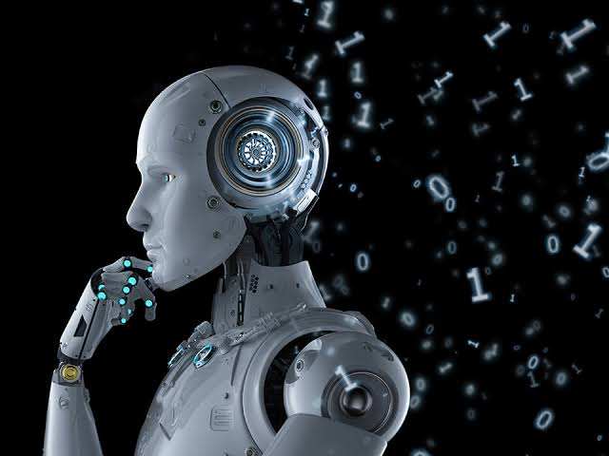
Overview of Robotics
Veritas University, Abuja, Nigeria
Department of Computer and Information Technology
Course: Introduction to Robotics (CSC439)
Lecturer: Engr. Calistus C. Chimezie

Slide 2
Contents
What is Robotics and what is a Robot?
Historical context
Robotics vs Automation
Categorization of Robotics
Types of Robots
Career perspective

Slide 3
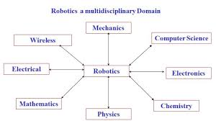
What is Robotics
Robotics is an interdisciplinary branch of science and engineering that covers the Research, Development and Operation of Robots.

Slide 4
Definition of Robots
There are many definitions of the term ‘Robot’.
A robot is a reprogrammable multifunctional manipulator designed to move material, parts, tools or specialized devices through variable programmed motions for the performance of a variety of tasks. Robotics Institute of America
A robot is a preprogrammed, and in many occasions reprogrammable autonomous or semiautonomous machine that is capable of sensing its environment and carrying out actions that tend to mimic human intelligence. Your Lecturer: Calistus C. Chimezie
Task: In your own words, describe a robot?

Slide 5
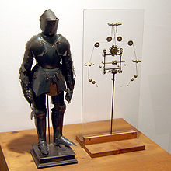
History of Robots
The term Robot first appeared in print in the 1920 play R.U.R (Rossum’s Universal Robots) by Karl Kapek, a Czechoslovakian playwright Karl Kapek.
Around the year, 1495 Leonardo da Vinci designed automated humanoid machines also referred to as mechanical knights (Italian: Automa Cavaliere).
Isaac Asimov coined and popularized the term robotics through many science-fiction novels and short stories in the 1930s. Asimov envisioned a brain for controlling robots even decades before the development of the first digital computers.
A model of Da Vinci’s humanoid robot with internal mechanisms

Slide 6
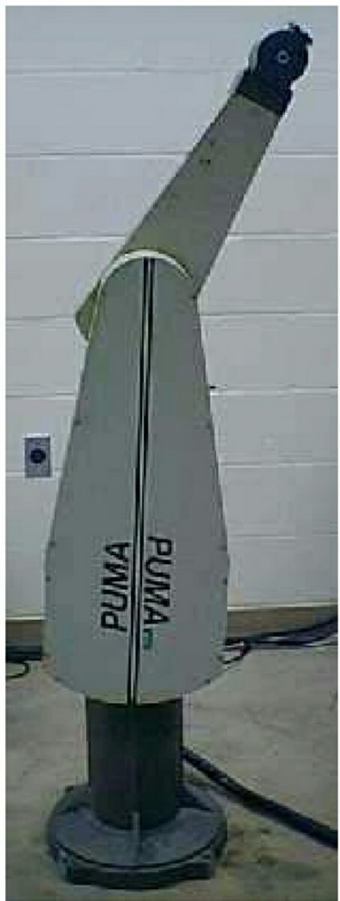
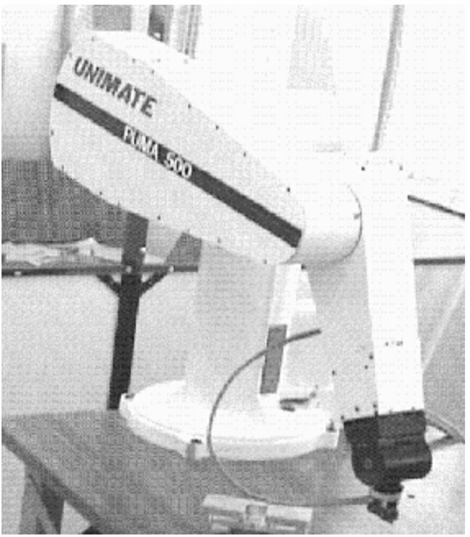
History of Robots cont’d…
The first modern industrial robot, the PUMA (Programmable Universal Manipulator Arm) was developed by Joseph Engleberger and George Devoe through their company, Unimation.
Joseph Engleberger and George Devoe are therefore considered the fathers of modern industrial robotics.

Slide 7
What is Automation and why is it relevant?
International Society of Automation (ISA) defines automation as;
“The creation and application of technology to monitor and control the production and delivery of products and services”.
Interaction:
Can a Robot therefore be considered an automation machine?
Can all robots be considered automation machines?
Can all automation machines be considered robots?

Slide 8
Robots as Automation machines
All robots are by design, automation machines.
Robotics can also be considered a branch of automation.
All automation machines are NOT Robots.

Slide 9
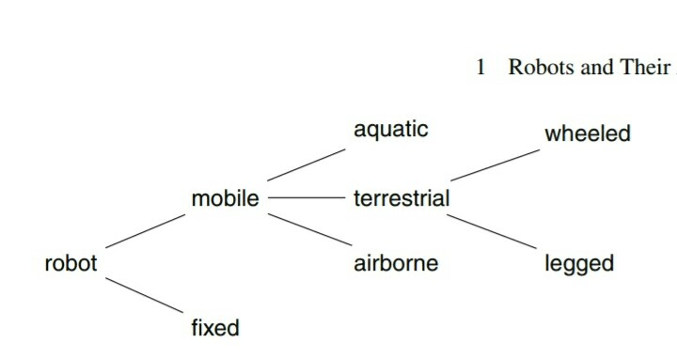
Classification of Robots: Fixed vs Mobile
Fixed Robots: Fixed robots work within a clearly defined environment. These are mostly industrial robots. Industrial robots perform specific repetitive tasks such as soldering, painting, and pick and place operations.
Mobile Robots: Mobile robots are expected to move around and perform tasks in large, ill-defined and uncertain environments.

Slide 10
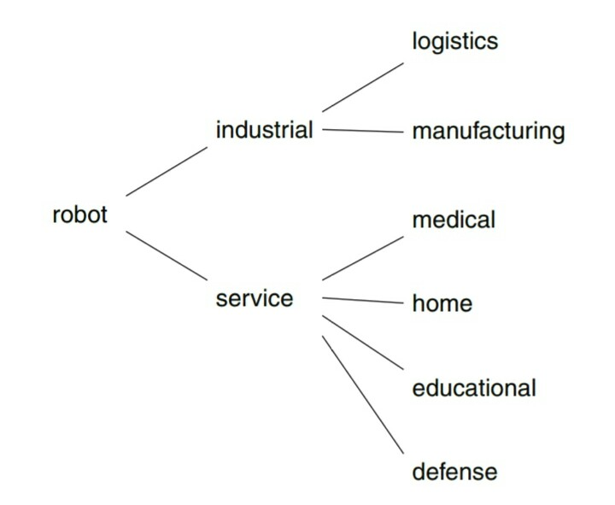
Classification by field of application: Industrial vs Service Robots
Industrial Robots work in well defined production environments and this makes their design a bit more simplified.
Service Robots assist humans in their tasks, from simple home chores such as vacuuming to more complicated tasks like medical surgery.

Slide 11
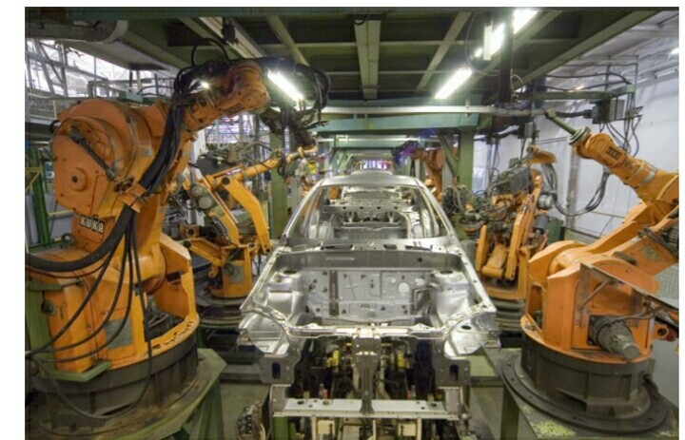
Pre-programmed

Slide 12
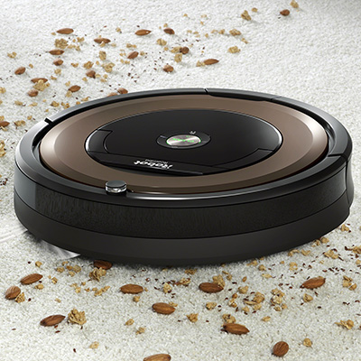
Types of Robots: Autonomous
Consumer Robots: Vacuum cleaner

Slide 13
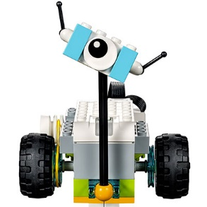
Types of Robot: Educational
Education Robots

Slide 14
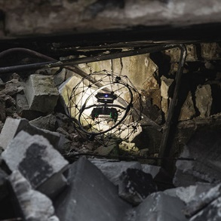
Types of Robot: Disaster Management (Autonomous)
Disaster Management Robots

Slide 15
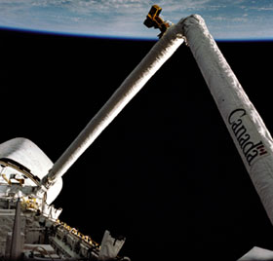
Types of Robot: Teleoperated
Robotic Arm on space shuttle

Slide 16
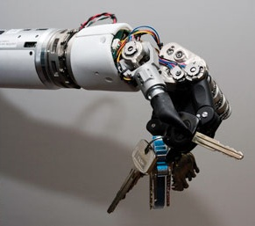
Types of Robots: Augmenting Robots
Robotic Artificial arm

